Slide 1
Models and Architecture

Slide 2
Objectives
Learn the basic design of a graphics system
Introduce pipeline architecture
Examine software components for an interactive graphics system

Slide 3
Image Formation Revisited
Can we mimic the synthetic camera model to design graphics hardware software?
Application Programmer Interface (API)
  Need only specify
    Objects
    Materials
    Viewer
    Lights
But how is the API implemented?

Slide 4
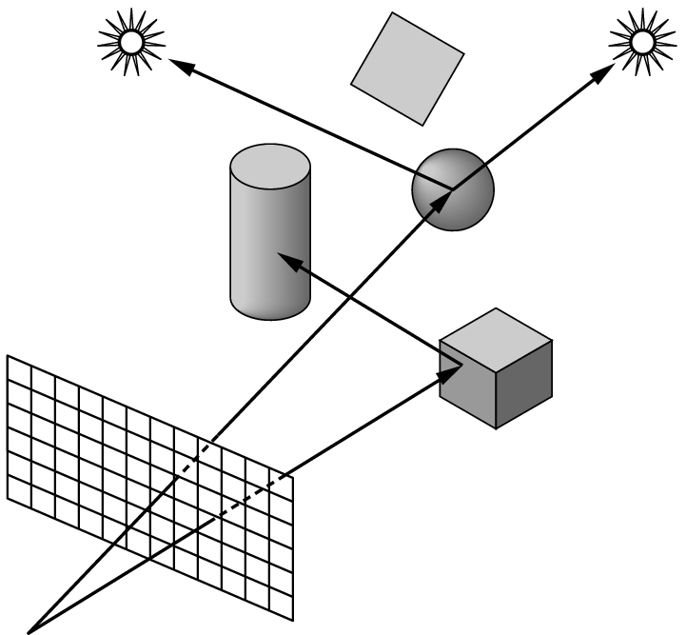
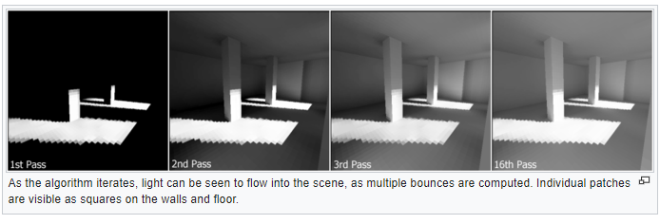
Physical Approaches
Ray tracing: follow rays of light from center of projection until they either are absorbed by objects or go off to infinity
  Can handle global effects
    Multiple reflections
    Translucent objects
  Slow
  Must have whole data base
  available at all times
Radiosity: Energy based
  Very slow

Slide 5
Practical Approach
Process objects one at a time in the order they are generated by the application
  Can consider only local lighting
Pipeline architecture
All steps can be implemented in hardware on the graphics card
application
program
display

Slide 6
Vertex Processing
Much of the work in the pipeline is in converting object representations from one coordinate system to another
  Object coordinates
  Camera (eye) coordinates
  Screen coordinates
Every change of coordinates is equivalent to a matrix transformation
Vertex processor also computes vertex colors

Slide 7
Projection
Projection is the process that combines the 3D viewer with the 3D objects to produce the 2D image
  Perspective projections: all projectors meet at the center of projection
  Parallel projection: projectors are parallel, center of projection is replaced by a direction of projection

Slide 8
Primitive Assembly
Vertices must be collected into geometric objects before clipping and rasterization can take place
  Line segments
  Polygons
  Curves and surfaces

Slide 9
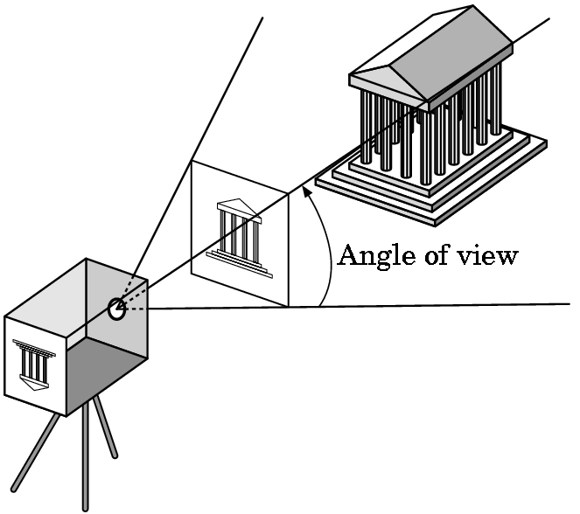
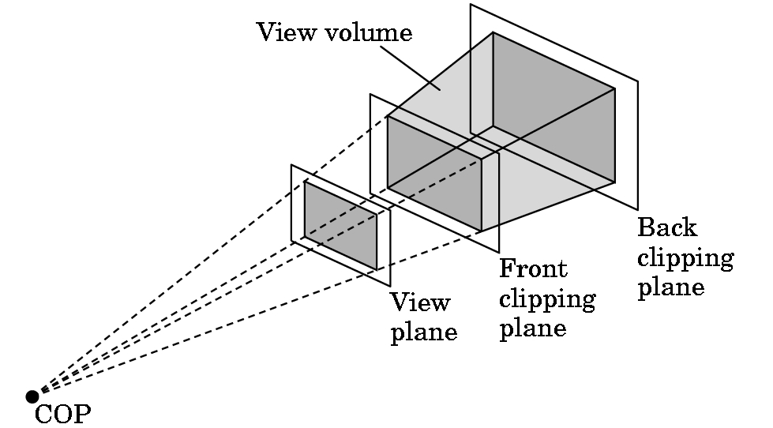
Clipping
Just as a real camera cannot “see” the whole world, the virtual camera can only see part of the world or object space
  Objects that are not within this volume are said to be clipped out of the scene

Slide 10
Rasterization
If an object is not clipped out, the appropriate pixels in the frame buffer must be assigned colors
Rasterizer produces a set of fragments for each object
Fragments are “potential pixels”
  Have a location in frame bufffer
  Color and depth attributes
Vertex attributes are interpolated over objects by the rasterizer

Slide 11
Fragment Processing
Fragments are processed to determine the color of the corresponding pixel in the frame buffer
Colors can be determined by texture mapping or interpolation of vertex colors
Fragments may be blocked by other fragments closer to the camera
  Hidden-surface removal

Slide 12
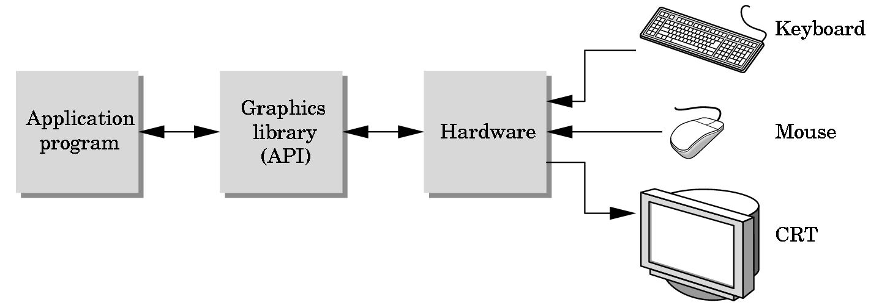
The Programmer’s Interface
Programmer sees the graphics system through a software interface: the Application Programmer Interface (API)

Slide 13
API Contents
Functions that specify what we need to form an image
  Objects
  Viewer
  Light Source(s)
  Materials
Other information
  Input from devices such as mouse and keyboard
  Capabilities of system

Slide 14
Object Specification
Most APIs support a limited set of primitives including
  Points (0D object)
  Line segments (1D objects)
  Polygons (2D objects)
  Some curves and surfaces
    Quadrics
    Parametric polynomials
All are defined through locations in space or vertices

Slide 15
Example (old style)
type of object
location of vertex
glBegin(GL_POLYGON)
glVertex3f(0.0, 0.0, 0.0);
glVertex3f(0.0, 1.0, 0.0);
glVertex3f(0.0, 0.0, 1.0);
glEnd( );
end of object definition

Slide 16
Example (GPU based)
Put geometric data in an array
Send array to GPU
Tell GPU to render as triangle
var points = [
vec3(0.0, 0.0, 0.0),
vec3(0.0, 1.0, 0.0),
vec3(0.0, 0.0, 1.0),
];

Slide 17
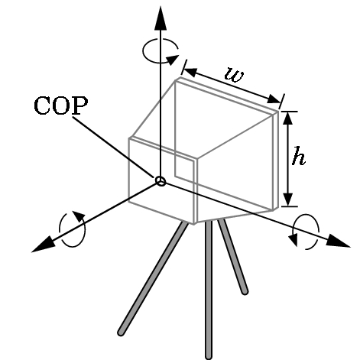
Camera Specification
Six degrees of freedom
  Position of center of lens
  Orientation
Lens
Film size
Orientation of film plane

Slide 18
Lights and Materials
Types of lights
  Point sources vs distributed sources
  Spot lights
  Near and far sources
  Color properties
Material properties
  Absorption: color properties
  Scattering
    Diffuse
    Specular

Slide 19
Modern OpenGL
Performance is achieved by using GPU rather than CPU
Control GPU through programs called shaders
Application’s job is to send data to GPU
GPU does all rendering

Slide 20
Immediate Mode Graphics
Geometry specified by vertices
  Locations in space( 2 or 3 dimensional)
  Points, lines, circles, polygons, curves, surfaces
Immediate mode
  Each time a vertex is specified in application, its location is sent to the GPU
  Old style uses glVertex
  Creates bottleneck between CPU and GPU
  Removed from OpenGL 3.1 and OpenGL ES 2.0

Slide 21
Retained Mode Graphics
Put all vertex attribute data in array
Send array to GPU to be rendered immediately
Almost OK but problem is we would have to send array over each time we need another render of it
Better to send array over and store on GPU for multiple renderings

Slide 22
OpenGL 3.1
Totally shader-based
  No default shaders
  Each application must provide both a vertex and a fragment shader
No immediate mode
Few state variables
Most 2.5 functions deprecated
Backward compatibility not required
  Exists a compatibility extension
Angel and Shreiner: Interactive Computer Graphics 8E © Pearson Education 2020

Slide 23
Other Versions
OpenGL ES
  Embedded systems
  Version 1.0 simplified OpenGL 2.1
  Version 2.0 simplified OpenGL 3.1
    Shader based
WebGL
  Javascript implementation of ES 2.0
  Supported on newer browsers
OpenGL 4.1, 4.2, …..
  Add geometry, tessellation, compute shaders

